Slide 1





Galala University
Data Pre-Processing
In Machine Learning
Presented by IEEE

Slide 2
Abstract
This presentation explains why data pre-processing is essential for improving the quality of data and making machine learning models more accurate. It begins with the (importance of data pre-processing) and how it helps reduce errors and organize data effectively. We will go over the (main types of pre-processing) steps, such as cleaning, transforming, reducing, extracting features, and splitting data, along with a simple, real-life example to make these ideas clear. (Practical tips) and (useful references) are also provided to help apply these methods. This overview aims to make data pre-processing understandable and show its key role in successful data analysis.

Slide 3
Overview
01
Introduction
05
Data reduction
08
Tips
02
Example in real life
06
Data splitting
03
Data cleaning
07
Evaluation
04
Data transformation

Slide 4

Introduction
Data pre-processing is like getting data "ready" for analysis, similar to organizing your workspace before starting a project. Raw data is often messy, with missing information, duplicates, or numbers and text that don’t make sense together. If we skip this step, it can confuse the analysis or lead to inaccurate results.

Slide 5

Plan a Party
How we will plan for the party?

Slide 6
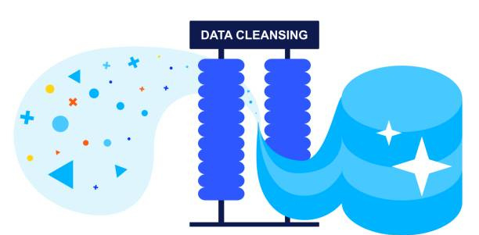
Data cleaning is the first and most important step in data pre-processing. It involves fixing or removing incorrect, incomplete, or irrelevant data. The goal is to improve data quality so that it doesn’t negatively impact analysis or machine learning models. Without data cleaning, errors in the data can lead to poor insights or inaccurate predictions.

Slide 7
Types of data cleaning
Correcting Errors and Outliers
Standardizing Data Formats
Handling missing values
Methods: Imputation (mean/median/mode), removal, or flagging missing data.
Methods: Manual inspection, statistical checks, or setting realistic limits on data values.
Methods: Use consistent date, number, and text formats across the dataset.
Presented by Juliana Silva

Slide 8
Handling missing values
Sometimes data has missing entries, like a blank cell in a spreadsheet.
Examples: Filling in missing ages with the average age, dropping rows where critical information is missing.

Slide 9
Correcting Errors and Outliers
Errors can include typos, out-of-range values, or formatting issues, while outliers are unusually high or low values that don’t fit the pattern.
Examples: Fixing a misspelled category name or removing an outlier price (like $1000 in a list of $10-$50 items).

Slide 10
Standardizing Data Formats
Different data formats can cause confusion, especially with dates or text fields.
Examples: Converting date formats to be consistent, changing all text to lowercase for uniformity.

Slide 11

Imagine a company analyzing customer orders. Their data includes:
Some orders have missing delivery dates.
A few customer names are duplicated.
Some order prices are way higher than expected (likely errors).
By handling these issues (e.g., filling missing dates, removing duplicates, flagging extreme prices), the company will get a cleaner, more accurate dataset that leads to better insights on customer behavior.
Business problem

Slide 12
Data Transformation

Slide 13

The main goal is to make different types of data comparable and easy to interpret, ensuring that machine learning algorithms can work effectively. This step often includes scaling, normalizing, encoding, or restructuring data into a usable format.
Data transformation involves changing the format, structure, or values of data so that it’s consistent and ready for analysis.

Slide 14
Types of Data Transformation
Scaling and Normalization
Feature Engineering
Encoding Categorical Variables

Slide 15
Scaling and Normalization
This adjusts numerical data so it falls within a specific range, making it easier for models to process and compare.
Examples: Converting heights from centimeters to a 0–1 scale; changing monthly sales to a standard deviation scale.
Methods: Min-Max scaling, standardization (Z-score), or log transformation.

Slide 16
Encoding Categorical Variables
Converting text-based categories (e.g., “red,” “blue,” “green”) into numerical values so they can be used in analysis.
Examples: Assigning 0 to “Male” and 1 to “Female” in a dataset, or creating a new column for each color in a dataset.
Methods: One-hot encoding, label encoding, or binary encoding.

Slide 17
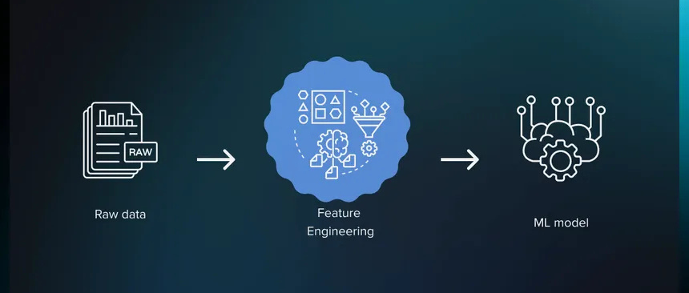
Feature Engineering
Creating new features based on existing data to highlight important patterns or relationships.
Example: Combining “first name” and “last name” fields into a single “full name” column; extracting "day of the week" from a date.
Methods: Combining fields, extracting parts of a field, or applying mathematical transformations.

Slide 18

Data cleaning
Data Transformation

Slide 19
Data Reduction

Slide 20
Types of Data Reduction
Feature Selection
Sampling
Dimensionality Reduction

Slide 21
Feature Selection
Choose only the most relevant features (columns) for the analysis and ignore the rest.
Example: In a dataset predicting car prices, selecting features like “year,” “mileage,” and “model” while ignoring “owner’s name” or “color.”
Methods: Manually picking important features, or using statistical tools like correlation analysis.

Slide 22
Dimensionality Reduction
Combine or transform features to reduce the number of columns, making the data simpler.
Example: In customer data, combining different types of interactions (e.g., website visits, app usage) into a single “user engagement” score.
Methods: Principal Component Analysis (PCA) or t-SNE.

Slide 23
Sampling
Use a smaller, representative part of the dataset rather than the entire dataset.
Example: Instead of analyzing 1 million customer entries, analyzing a sample of 10,000 customers.
Methods: Random sampling or systematic sampling.

Slide 24
Data Splitting

Slide 25
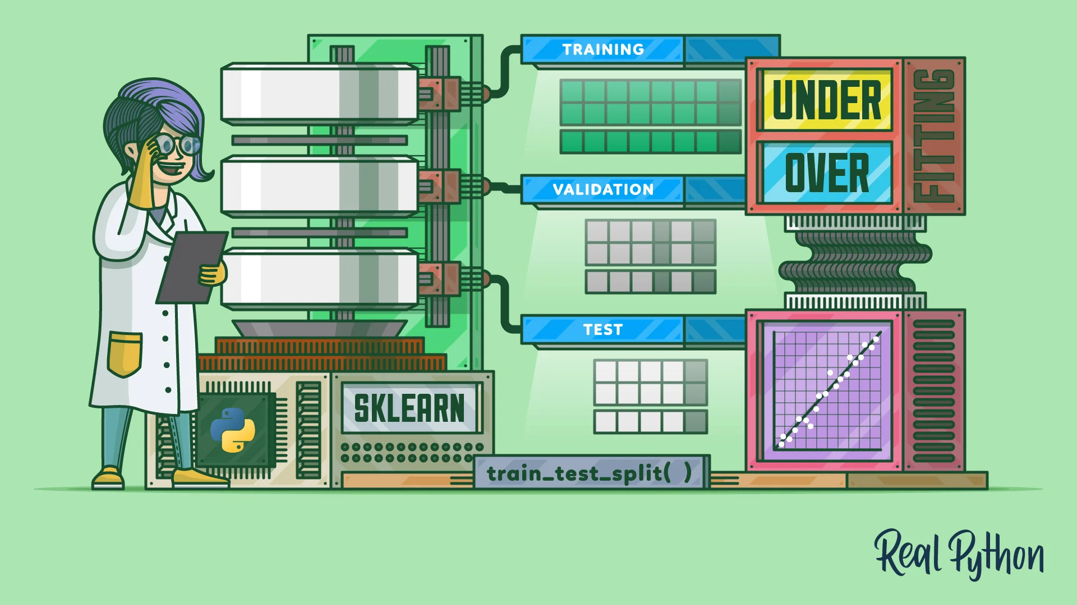

Slide 26
Data Splitting
Data splitting is the process of dividing a dataset into different parts to ensure that machine learning models are trained and tested effectively. It helps evaluate how well a model will perform on new, unseen data. Typically, data is split into training and testing sets, and sometimes a validation set is added for fine-tuning.

Slide 27
Types of Data Splitting Sets
Training Set
Validation Set
Testing Set

Slide 28
Training Set
The portion of data used to train the model, allowing it to learn patterns and relationships.
Example: Using 70% of a customer dataset to teach a model to predict purchase behavior.
Purpose: Helps the model "learn" from data so it can make accurate predictions.

Slide 29
Testing Set
A separate portion of data used to test the model after training to evaluate its accuracy and generalization.
Example: Using the remaining 30% of the customer dataset to see how well the model predicts new customer purchases.
Purpose: Ensures that the model performs well on new data, not just on data it has seen.

Slide 30
Validation Set
An additional subset used during training to fine-tune model parameters and prevent overfitting.
Example: Splitting 10% from the training data to validate and adjust model settings before final testing.
Purpose: Helps optimize the model and select the best version to avoid overfitting or underfitting.

Slide 31

Start with Data Cleaning First
Use Feature Engineering for Better Model Performance
Handle Outliers Carefully
Document Every Step
Test with Different Preprocessing Strategies

Slide 32
Galala University
Thank
You
Presented by IEEE

